Slide 1
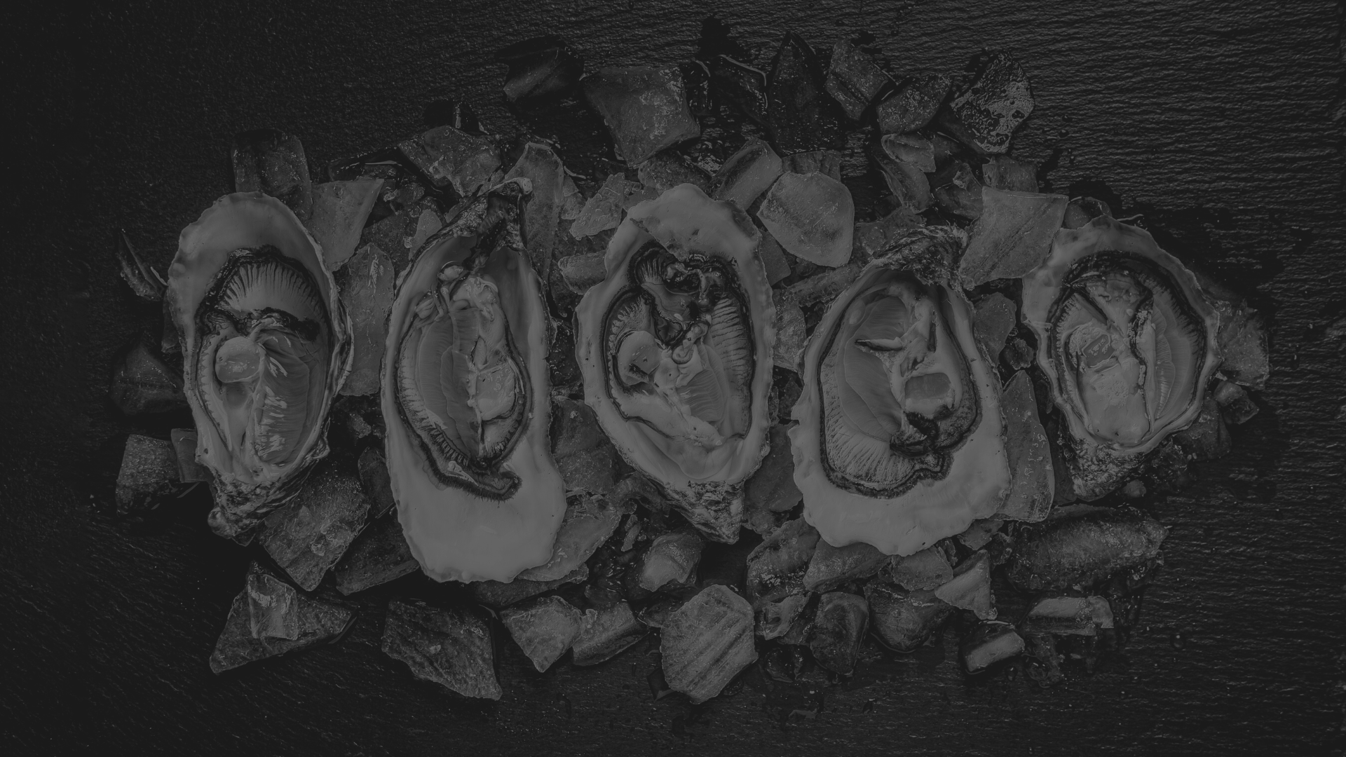
Oyster genomics for everyone:
applications to conservation, management, and aquaculture
University of Rhode Island
Department of Biological Sciences

Slide 2
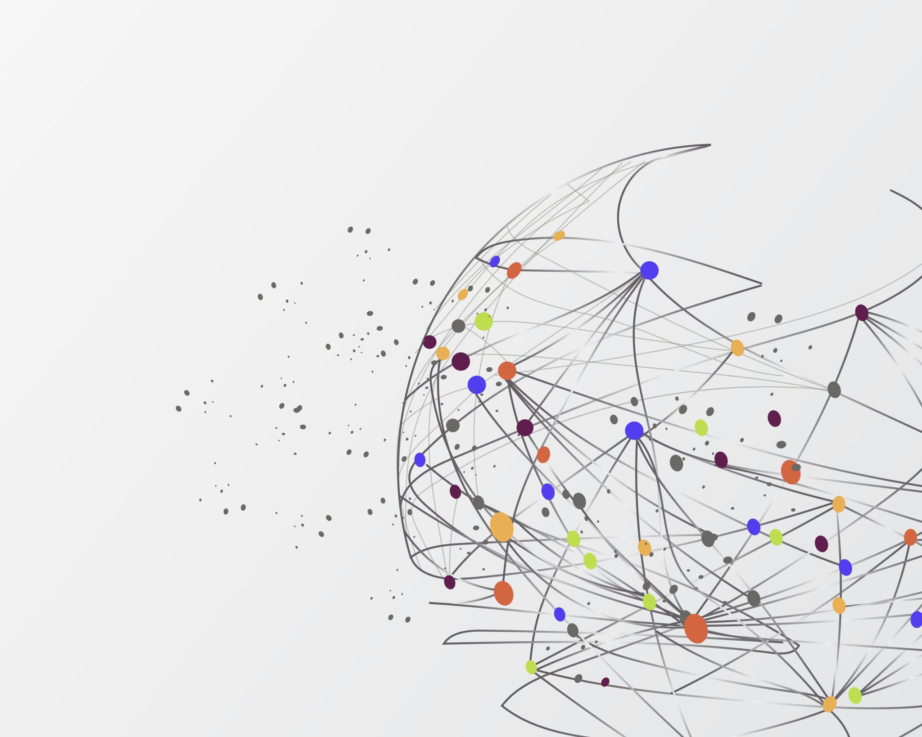
Calculating genetic diversity
Oyster Genomics for everyone Workshop
NACE/MAS 2024

Slide 3
What can SNPs do?
How genetically diverse are stocks, lines, individuals?
How closely related are stocks, lines, populations?

Slide 4
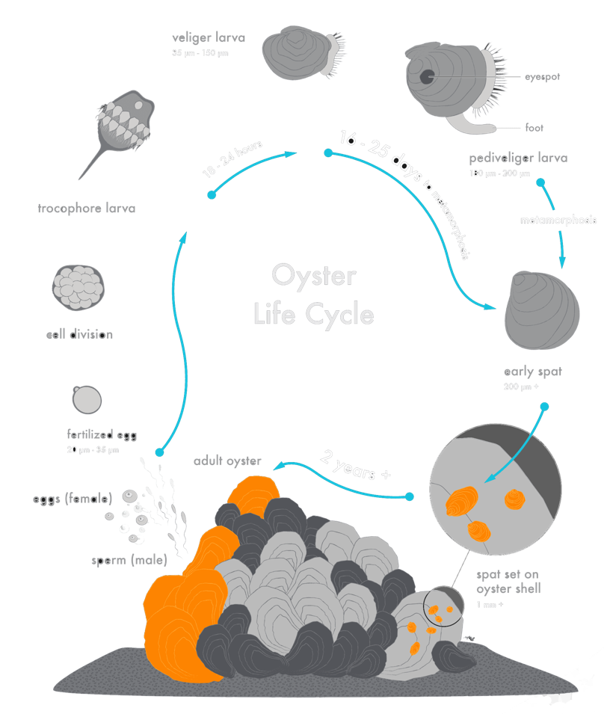
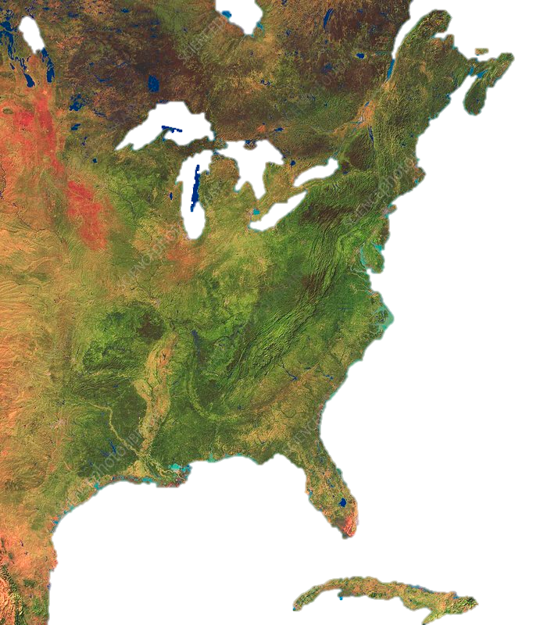
The eastern oyster (Crassostrea virginica)
https://www.nantucket-ma.gov/1425/Shell-Recycling-Program

Slide 5
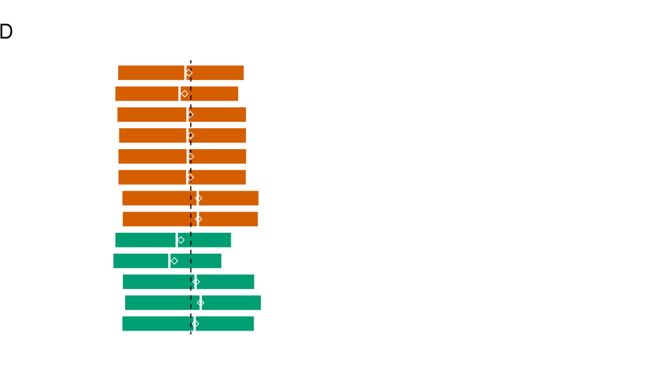
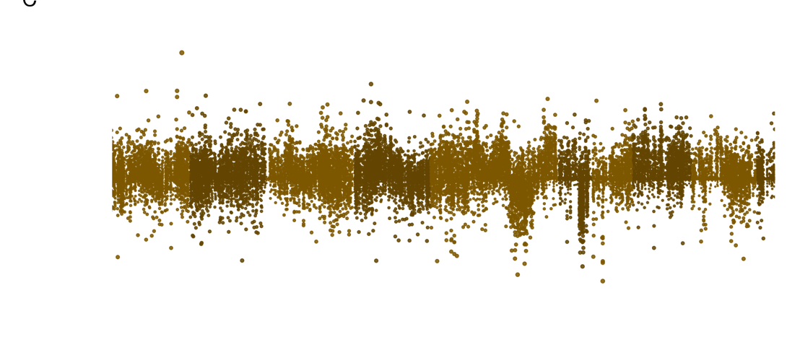
Wild oysters have higher $π$ than selected lines*

Slide 6
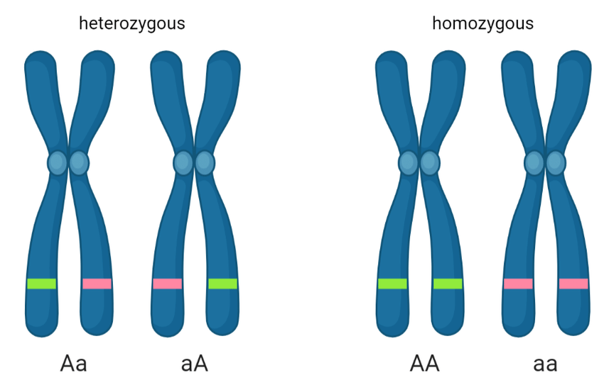
Heterozygosity
At the population scale, we are calculating what percentage of individuals are heterozygous at a particular SNP
Figure from (Alotaibi 2022)

Slide 7
F_{IS} – Calculating inbreeding coeffecient
F_{IS} = 1 – (H_{I} / H_{S})
It ranges from 0 to 1 with
Values close to 0 indicate little inbreeding
Values close to 1 indicate high levels of inbreeding
The proportion of the total inbreeding within a population due to inbreeding within sub-populations.

Slide 8
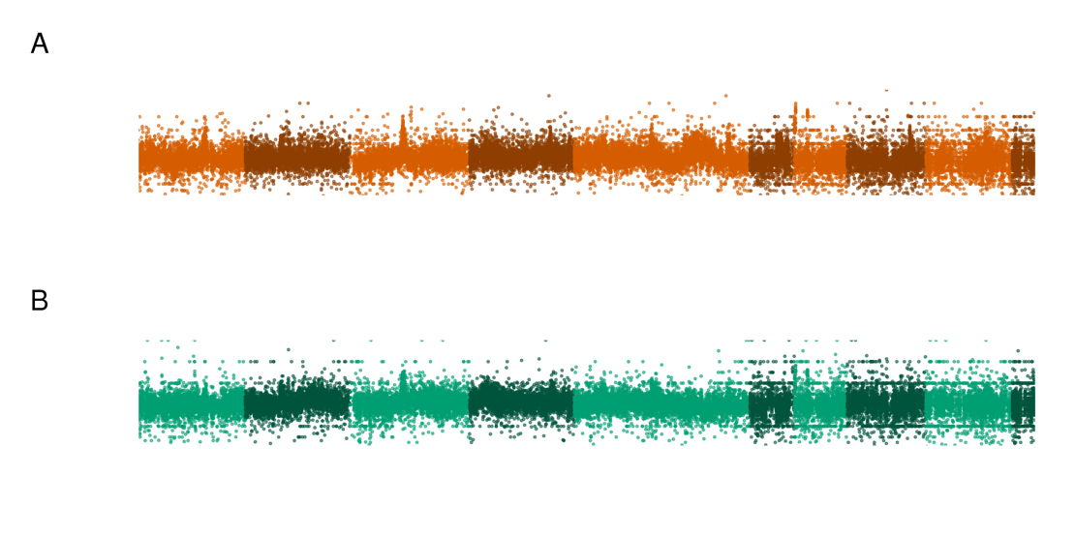
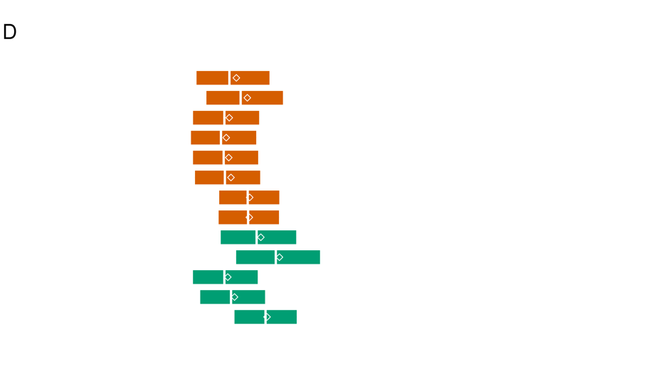
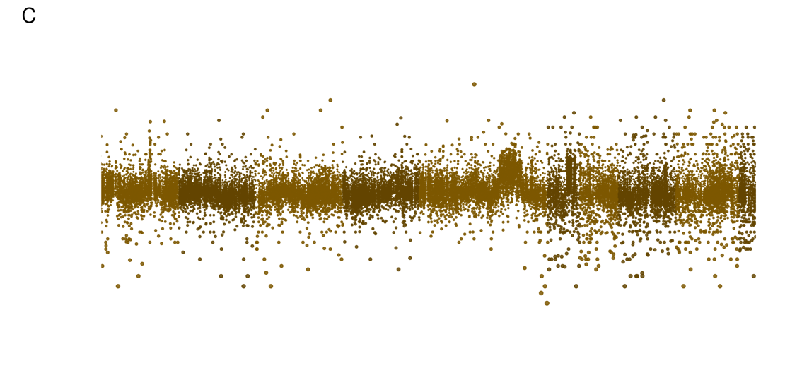
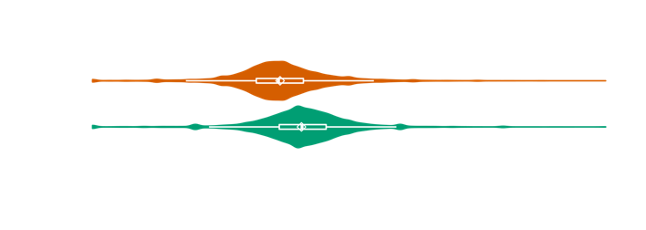
Selected oysters have more inbreeding than wild

