Slide 1
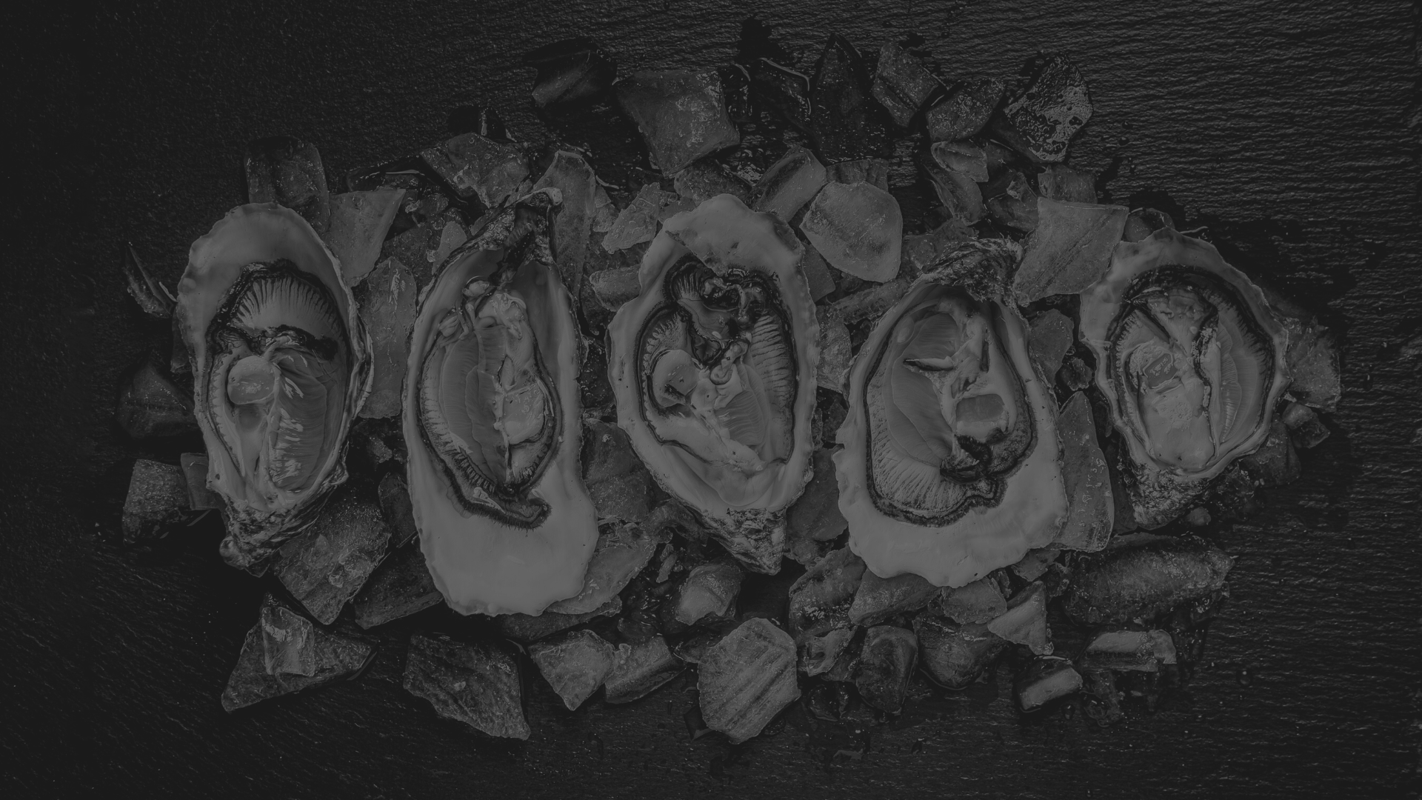
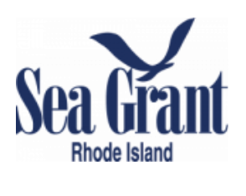
Oyster genomics for everyone:
applications to conservation, management, and aquaculture
University of Rhode Island
Department of Biological Sciences

Slide 2
Acknowledgements
Many thanks to the NACE/MAS organizers for helping to facilitate this workshop!
Emily Whitmore
Anne Langston
Christopher Davis
Lisa Wilke
Special thanks to RI Sea Grant for supporting this workshop and participants!
Thanks right, we can help cover some of your costs for attending this workshop!
Please fill out the google form below (QR code too)
https://forms.gle/f9RFDuhXF8ruozQ66
Thanks to all presenters!

Slide 3
Today’s Workshop
Lightning talks- What can genomic data tell us?
Understanding Oyster Population Connectivity and Adaptation in Narragansett Bay
Amy Zyck
Genomic and phenotypic variation in wild and selectively bred oysters
Angel Carrasquillo
Do farm oysters contribute to ecosystem services? Assessing interbreeding between aquaculture strains and native stocks
Yuqing Chen
No oysters were harmed in the making of this: how to non-destructively sample oyster DNA
USDA- ARS
Part 2: Hands-on workshop with the Eastern Oyster SNP Breeding Array
From DNA to SNP and what is a SNP anyway?
Introduction to R
Calculating Genetic Diversity
Principal Component Analysis and Discrimininant Analysis

Slide 4
So why have this workshop now?
The eastern oyster genome is an excellent and improved resource
The eastern oyster Breeding SNP Array is affordable and accessible
DNA can be sampled from oysters non-destructively

Slide 5
So why have this workshop now?
The eastern oyster genome is an excellent and improved resource

Slide 6
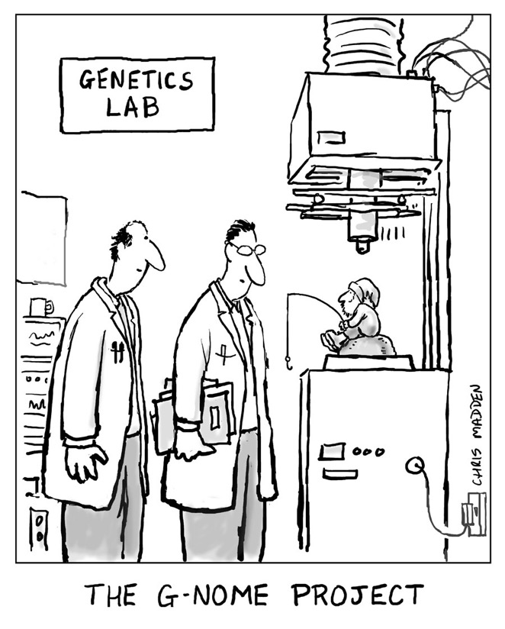
The eastern oyster genome
First chromosome level assembly published on NCBI in 2017 by group led my Marta Gomez-Chiarri and Dina Proestou

Slide 7
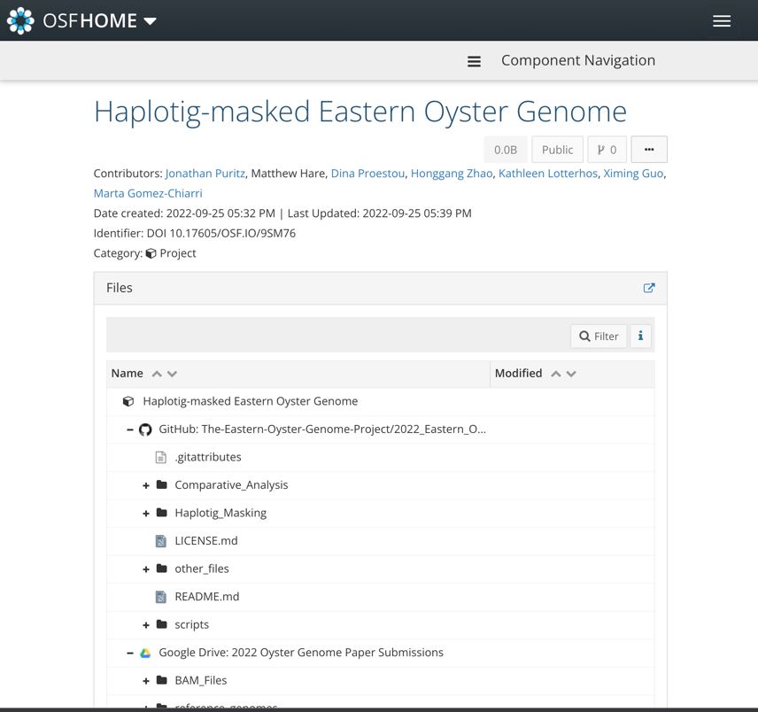
The eastern oyster genome
First chromosome level assembly published on NCBI in 2017 by group led by Marta Gomez-Chiarri and Dina Proestou
Developed a protocol to mask haplotigs within an existing genome
Relies upon the purge_haplotigs¹
Fully open and reproducible
Open Science Framework
Github Rmarkdown Protocol
Published in Mol Eco Res
BioRxiv. DOI: 10.1101/2022.08.29.505626
The assembly has been greatly improved!
Roach, M.J., Schmidt, S.A. & Borneman,. BMC Bioinformatics 19, 460 (2018). https://doi.org/10.1186/s12859-018-2485-7

Slide 8
So why have this workshop now?
The eastern oyster genome is an excellent and improved resource
The eastern oyster Breeding SNP Array is affordable and accessible

Slide 9
Genomics Workflow
dDocent
SNPs
FASTQ

Slide 10
Genomics Workflow with a SNP ARRAY
SNPs

Slide 11
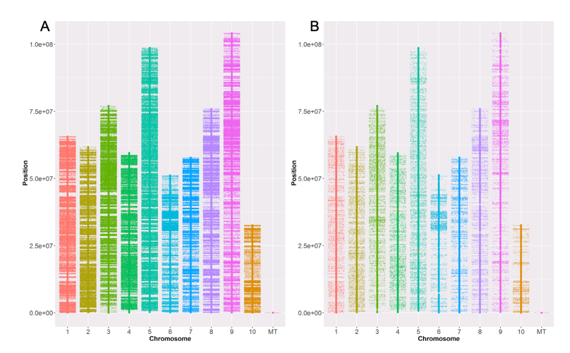
Eastern Oyster Breeding SNP Array
Sequenced 269 individuals to ~15X coverage
Initial filtering produced 10,628,193 biallelic SNPs
Final filtering- 3,661,861 biallelic SNPs
Included:
Known outliers loci ~43,000
Mitochondrial SNPs ~ 33
399 non-polymorphic loci
13 oyster pathogens
Only 2,691,166 SNPs were recommended for the array
Marker composition | 566K ~$50 per sample | 66K ~$25 per sample
Oyster SNPs | 566,262 | 65,893
Nuclear | 566,229 | 65,862
Genic | 47,426 | 22,984
Genomic | 518,803 | 42,878
Mitochondrial | 33 | 31
Pathogen markers | 756 | 756
Total markers | 567,018 | 66,649

Slide 12
So why have this workshop now?
The eastern oyster genome is an excellent and improved resource
The eastern oyster Breeding SNP Array is affordable and accessible
DNA can be sampled from oysters non-destructively

