Slide 1
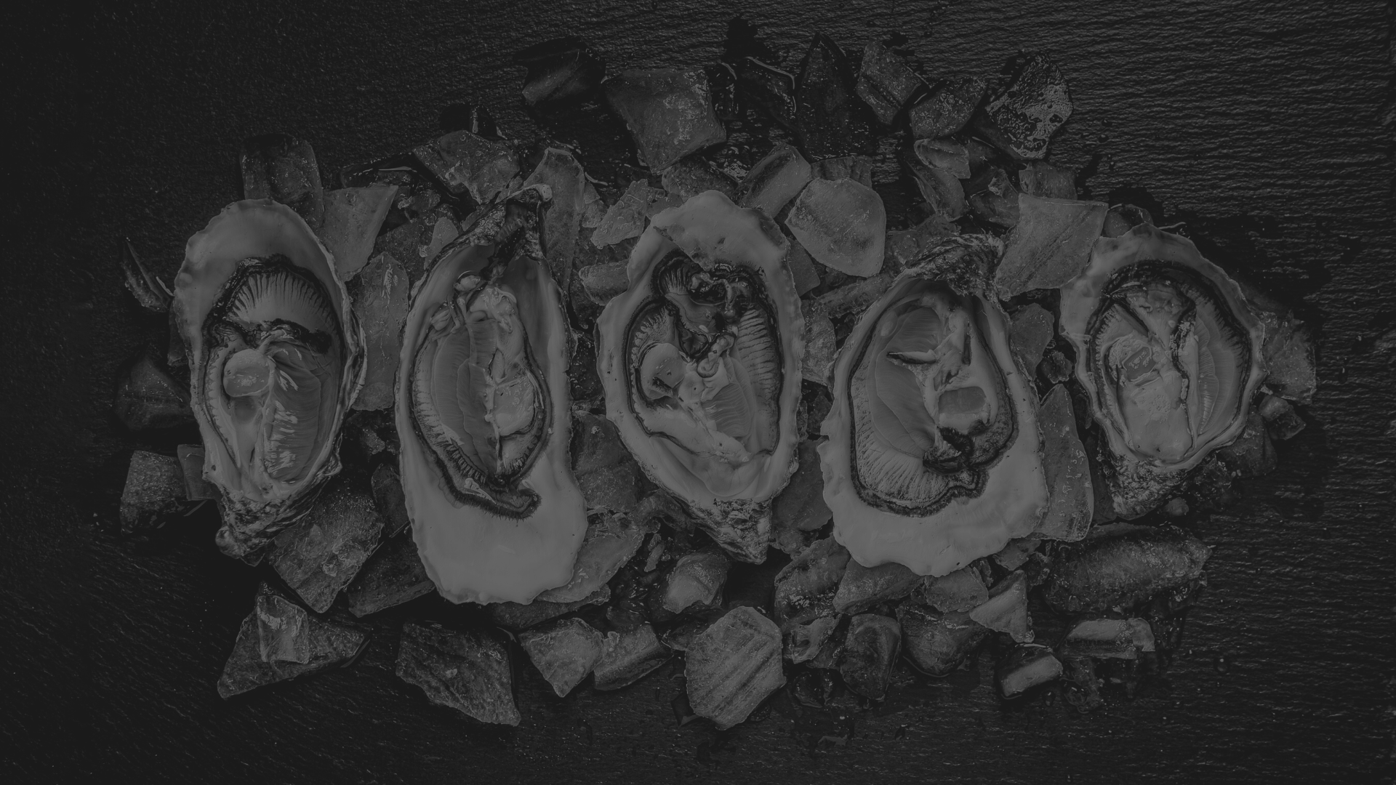
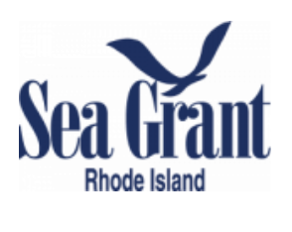
Oyster genomics for everyone:
applications to conservation, management, and aquaculture
University of Rhode Island
Department of Biological Sciences

Slide 2
PCA and Discriminant Analysis
Oyster Genomics for everyone Workshop
NACE/MAS 2024

Slide 3
What can SNPs do?
How genetically diverse are stocks, lines, individuals?
How closely related are stocks, lines, populations?

Slide 4
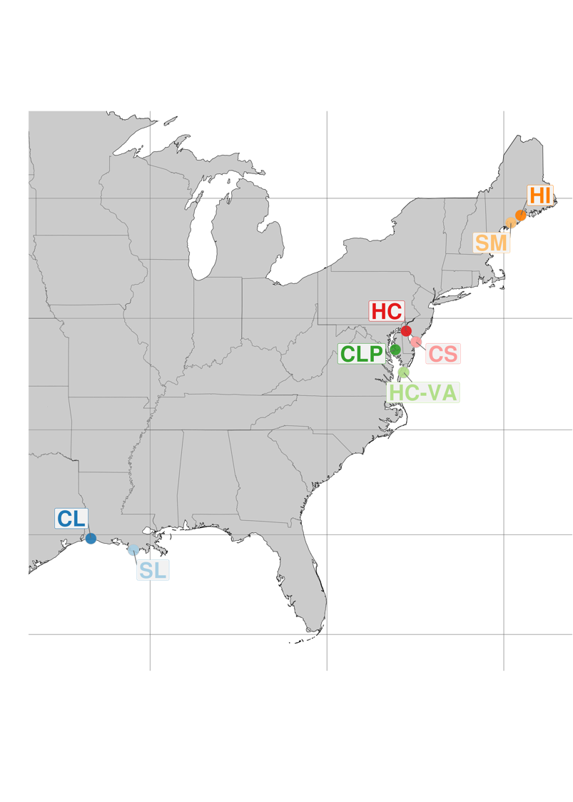
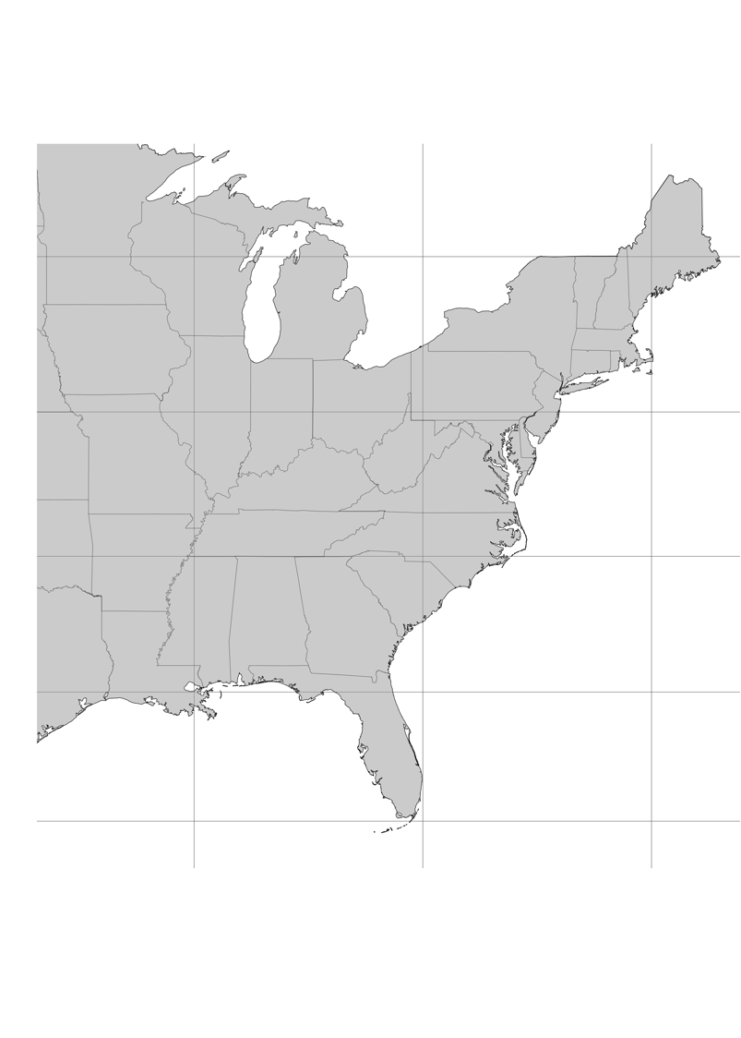
Oysters sampled for resequencing
UMFS
1986
NEH
1966
LOLA
2008
DEBY
1987
OBOY
1999

Slide 5
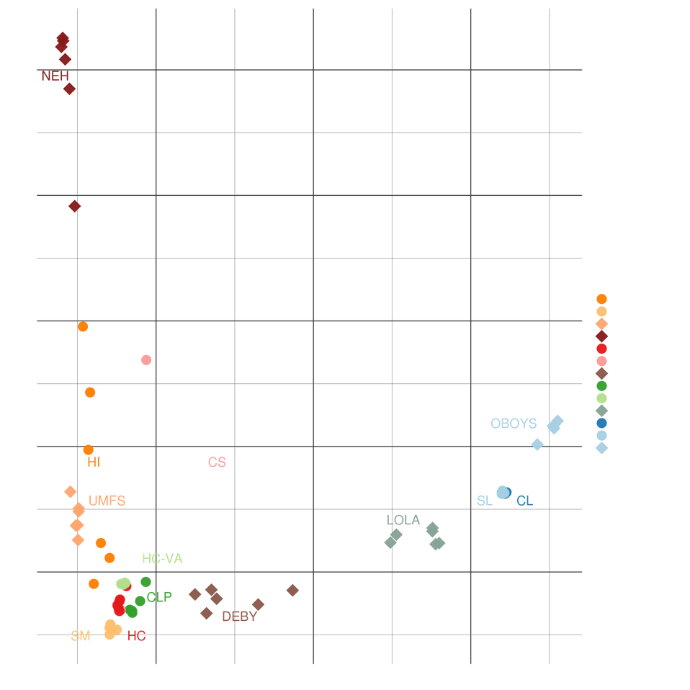
Populations structured by ocean basin & selected lines

Slide 6
What is a population?
PCA
Imagine creating a giant matrix of genotypes arranged in rows of individuals and columns of loci
PCA reduces the dimensionality of all genetic variation by eigendecomposition
Axes of variation are defined by linear combinations of loci
 | Locus 1 | Locus 2 | Locus 3 | Locus 4
Individual 1 | 0 | 1 | 2 | 0
Individual 2 | 1 | 1 | 2 | 1
Individual 3 | 0 | 0 | 0 | 1
Individual 4 | 2 | 2 | 1 | 0

Slide 7
What is a population?
PCA
Imagine creating a giant matrix of genotypes arranged in rows of individuals and columns of loci
PCA reduces the dimensionality of all genetic variation by eigendecomposition
Axes of variation are defined by linear combinations of loci
Novembre et al. 2008

Slide 8
What is a population?

Slide 9
What is a population?
Novembre et al. 2008

Slide 10
DAPC
DAPC
Uses principal component analysis to decompose the variation in allele frequencies into discrete axes
Groups can be input or inferred
Within group variation is minimized and between group variation maximized.
Can be used with either neutral or adaptive loci
Novembre et al. 2008

Slide 11
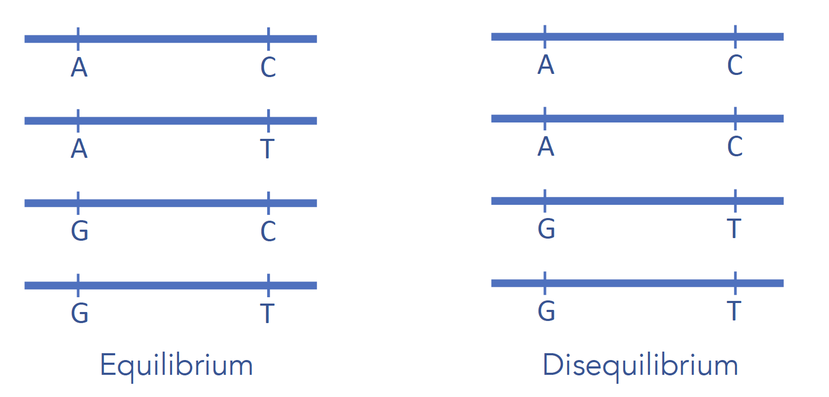
Linkage Disequilibrium (LD) Problem
LD is a fancy way of saying that there is a nonrandom associate of alleles at different loci
Adopted from Physalia course by Nina Therkildsen and Honggang Zhao

Slide 12
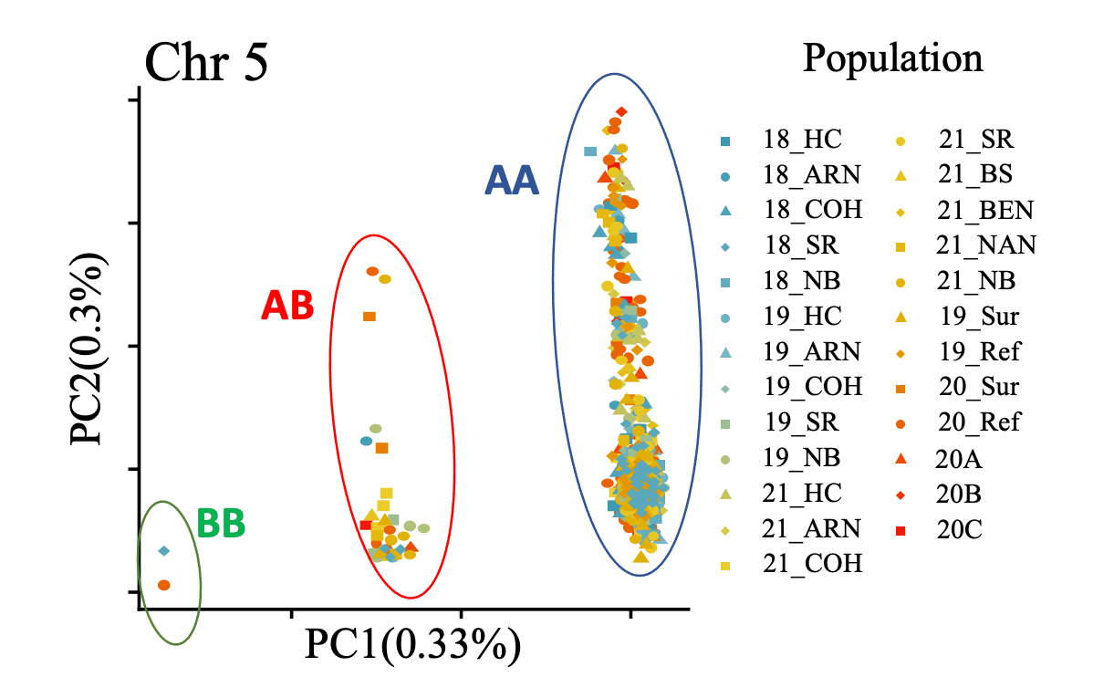
Linkage Disequilibrium (LD) Problem
Many analyses, like PCA, DAPC assume that SNPs are independent from each other
High values of LD can create artifactual relationships in PCA
Adopted from Honggang Zhao

Slide 13
So why have this workshop now?
The eastern oyster genome is an excellent and improved resource
The eastern oyster Breeding SNP Array is affordable and accessible
DNA can be sampled from oysters non-destructively

Slide 14
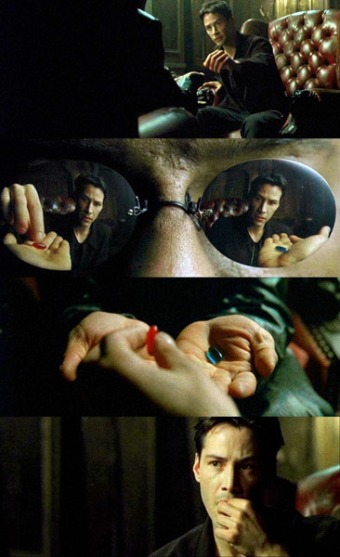
The rabbit hole only gets deeper
Remember, all I'm offering is the truth – nothing more

